Slide 1
Jira Software
Basic Training
November 2020

Slide 2
Agenda
01 | JIRA Software in Edge’s eco-system
02 | JIRA Software login at Humana Edge
03 | Introduction to the issue
04 | Introduction to the project
05 | Working with multiple issues
- core capabilities
- Jira Software agile capabilities
06 | Miscellaneous
07 | Documentation
08 | Requesting Help

Slide 3
JIRA Software in Edge’s eco-system
And scope of today’s training

Slide 4
Jira Software in the Edge eco-system
Agile Systems
Here is a brief overview of Jira Software and some of the other Edge systems it ingrates with…
Active Directory
PowerBi
ServiceNow
Today’s Training
JIRA Align
SAFe – Scaled Agile Framework
JIRA Software
Agile Projects
GitLab
Source Code Management
MS Teams
Collaboration
qTest
Test Suite Management
User Configurable
In Place
Possibly Future

Slide 5
JIRA Software Access
Login into Humana Edge’s Jira Software instance

Slide 6
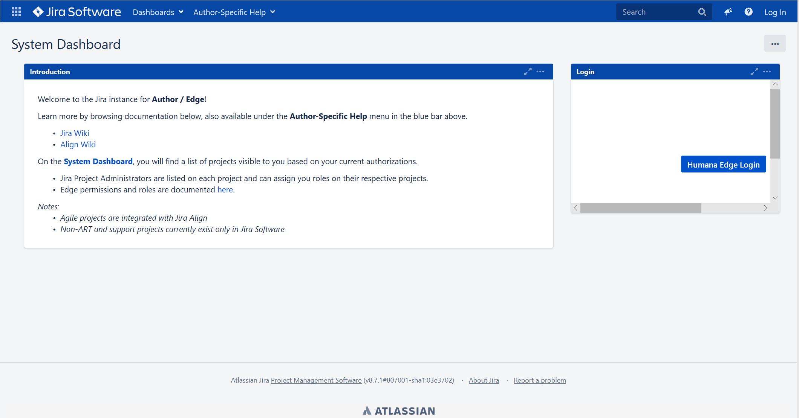
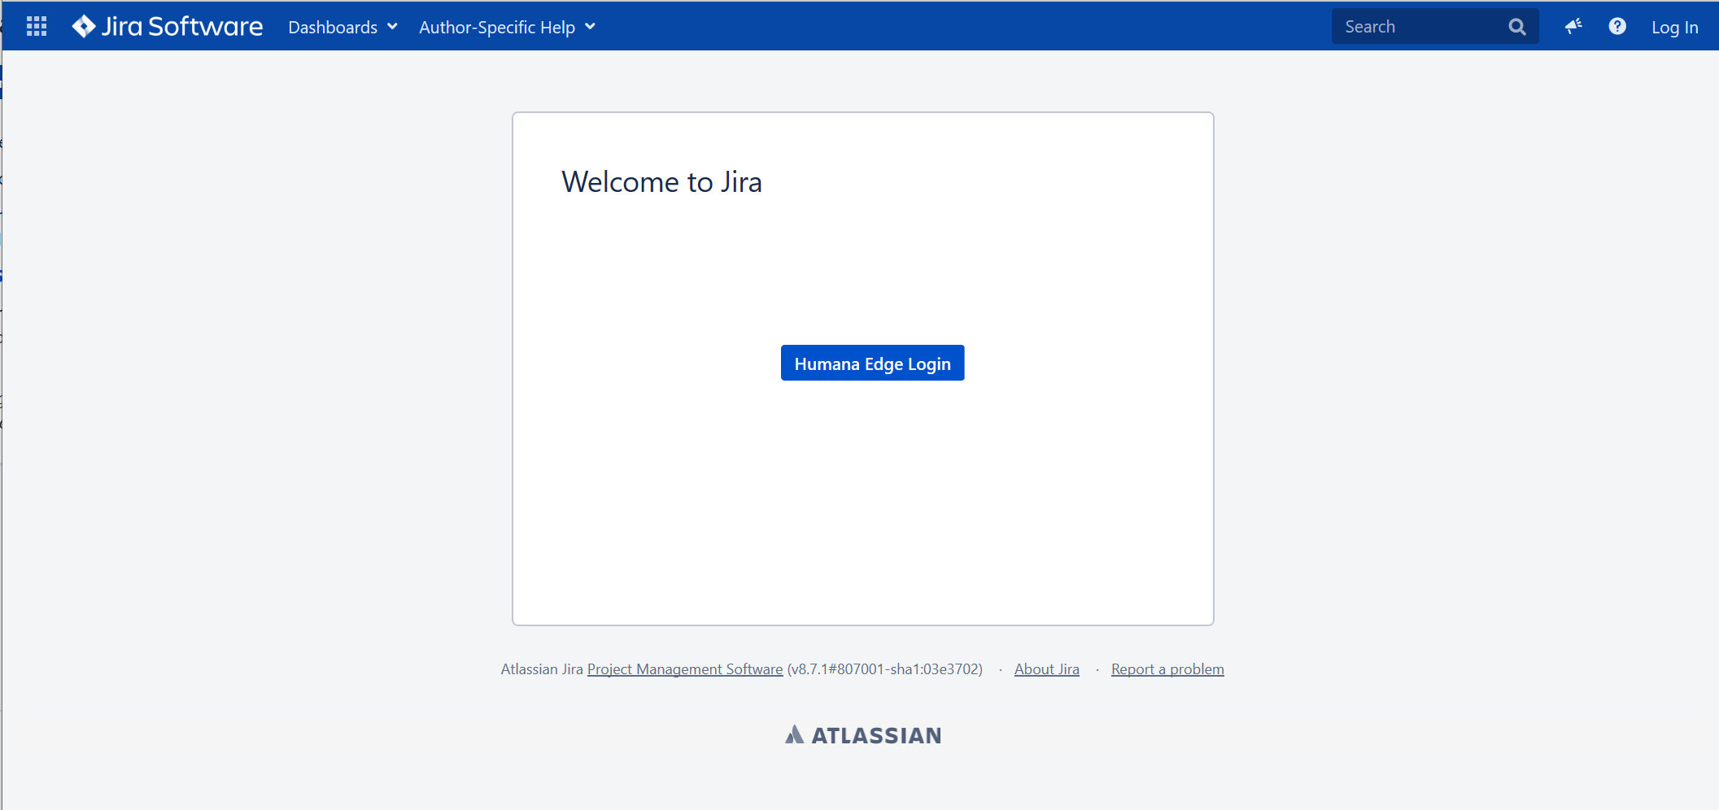
Login into JIRA Software
Integration with Microsoft Active Directory (AD)
User must exist in AD and be a member of a JIRA security group for basic access
User must be manually inserted in JIRA, where additional authorization are managed via JIRA internal groups
Login achieved through the Humana Edge login button
You may be redirected to the Microsoft authentication portal and/or have to use DUO to complete the authentication

Slide 7
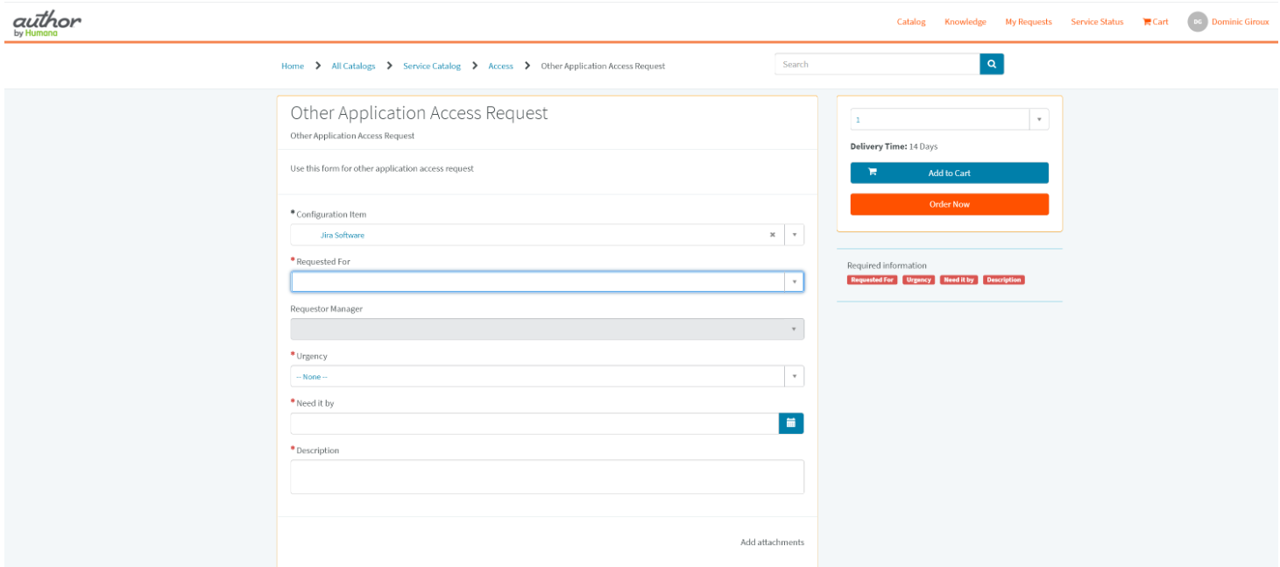
Requesting Access
Jira is a web application. No software installation needed.
Access must be requested via a ServiceNow request.
Go to the ServiceNow Portal
The link above should take you directly to the Other Application Access Request. If not, click on
I need Something
Access Requests
Other Application Access Request
Search and select Jira Software in the Configuration Item field
Find the person needing access in the Requested For field
Edge credentials are needed for Jira access. If the person cannot be found in this field, you need to secure Edge credentials for them first...

Slide 8
Introduction to the issue
What’s an issue and how to work with one

Slide 9
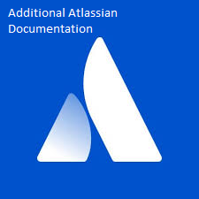
What’s an issue
Issue
Types
At JIRA’s core is the “issue”, essentially a configurable, flexible database record
- “system” or “standard” fields are available for every issue
JIRA is extremely configurable:
Define any number of “issue types” and customize them with any number of “custom” fields (attributes)
Customize issue types by project context, meaning the same issue type may be different across projects
Concretely:
A bug could have 24 fields where a task could have 21 fields
A bug in project A could be 24 fields but 27 fields in project B
Jira
Issues
Custom Field
Types
Issue (logical)
Custom Fields
Values
Field Configurations
Projects
Click here for Actual Jira 7 Data Model

Slide 10
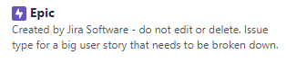
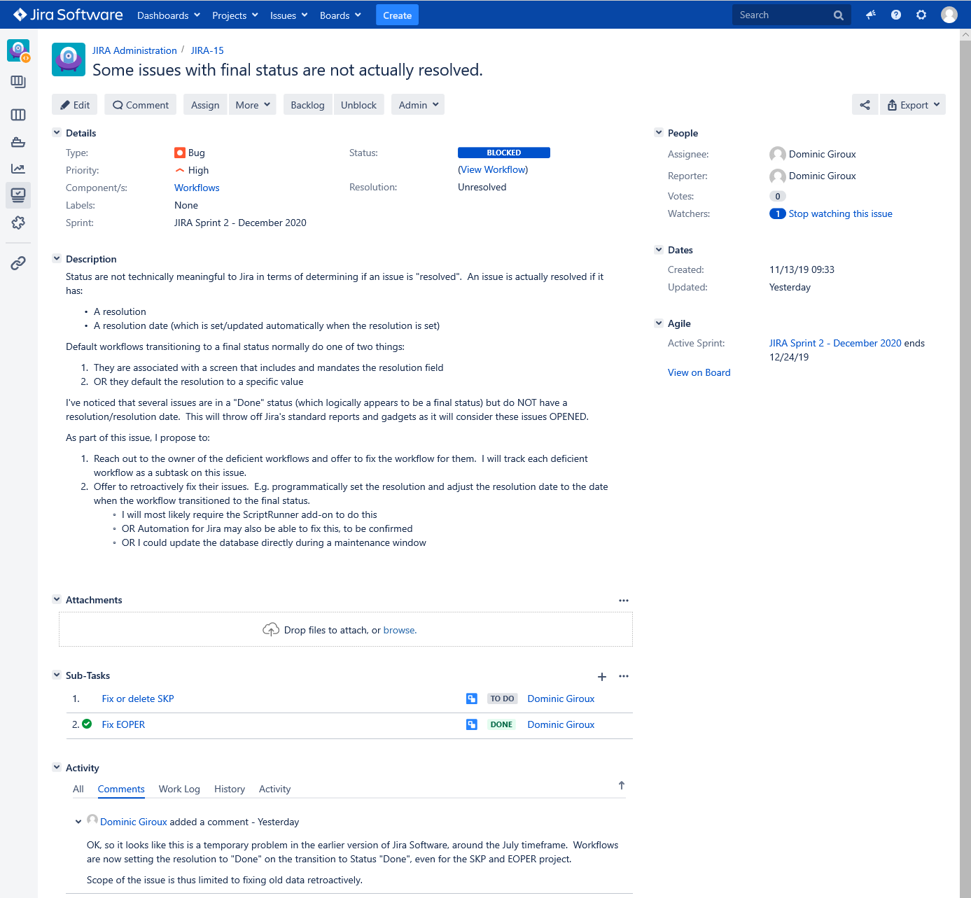

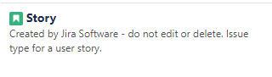


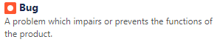
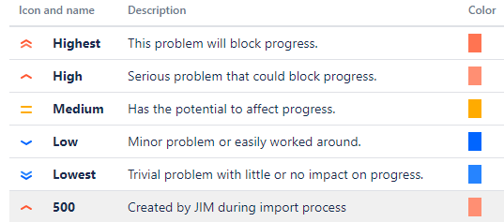
Issue View Screen – Key Fields
You can access an issue directly by typing the issue key in the search field
Project Name
Issue Key
Summary
Status, driven by workflow
Really how Jira decides if an issue is closed:
unresolved = open
any resolution = closed
Issue Type Schemes let us control what issue types are available in what project…
Components are defined by project.

Slide 11
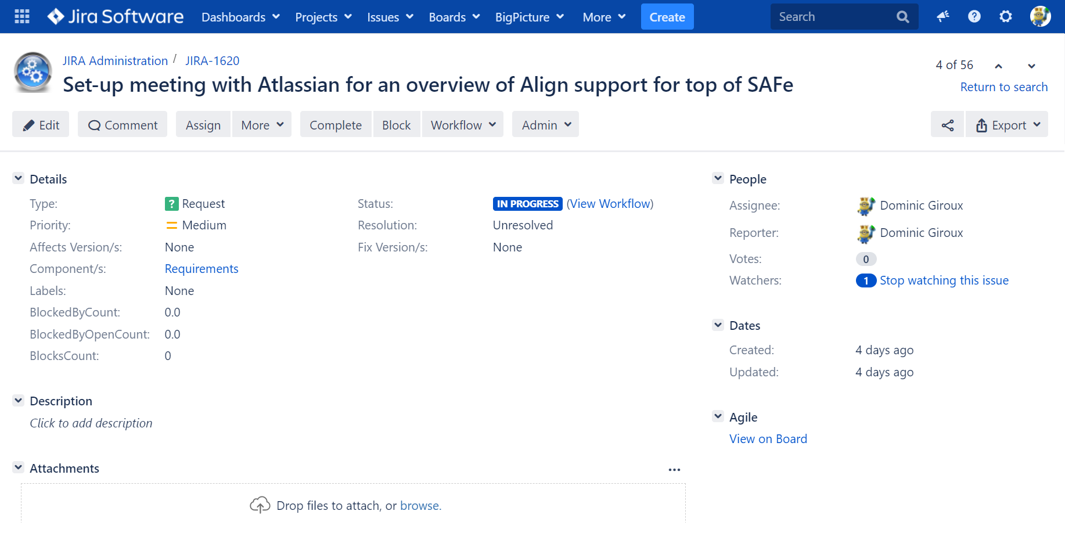
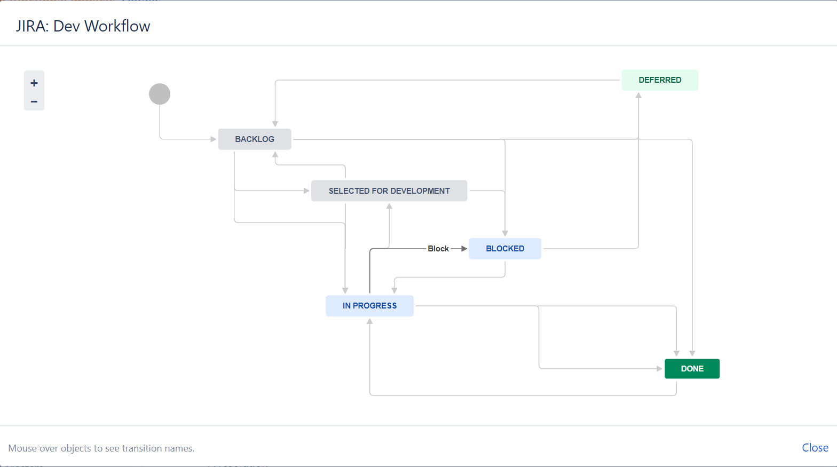
Issue View Screen – Workflow
The workflow is the life cycle of the issue.
Workflow can be different for different issue types, within a project and across projects.
You can “read” a workflow.
Let your mouse hover over the transition (line) you want to accomplish and it will indicate what the transition action button is…

Slide 12
Issue View Screen – Key Fields (Continued)
Jira user responsible for resolving the issue
Everyone listed here will be notified of changes on the issue.
Notifications can be fine-tuned by project using notifications schemes (currently global)
Usually the creator but not necessarily so. This is the person to contact if you need more info, and should be considered the primary stakeholder…
Additional stakeholders. By default, you are automatically added as a watcher if you comment on an issue (this behavior can be changed in your profile).
Key system dates:
Created
Due Date
Updated
Resolved
NOTE: JIRA only display fields that have values!
Custom Fields can be added by JIRA Applications (Software, Service Desk), Apps (a.k.a. add-ons) and by administrators.
Custom JIRA Software fields

Slide 13
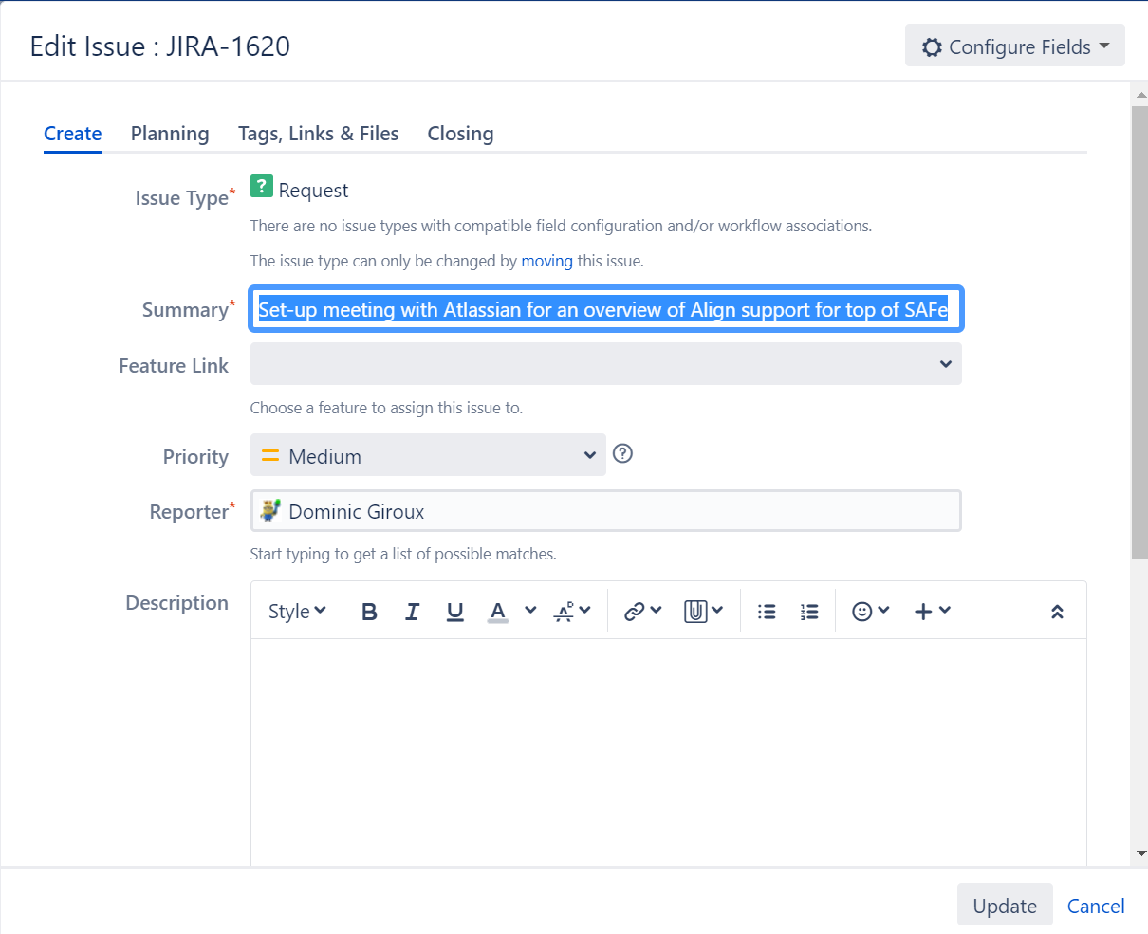
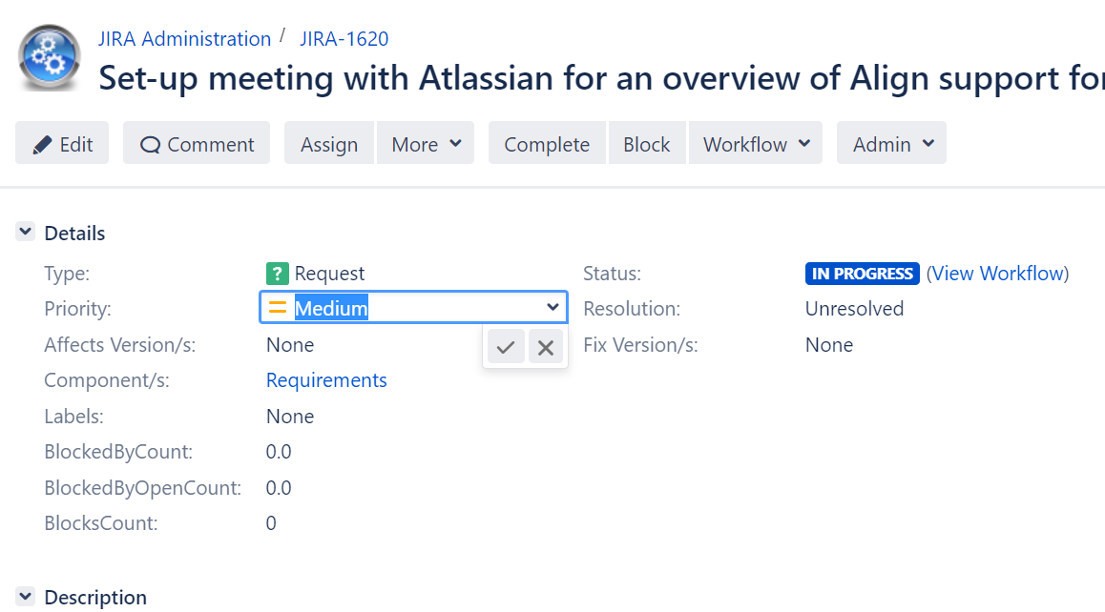
Issue View Screen – Edit Dialog vs In-line Editing)
Edit dialog lets you make multiple changes at once, with single notification.
Empty fields show.
In-line edit lets you change most field already present directly.
Notifications “digest” of recent change on the issue occur every 5 minutes.

Slide 14
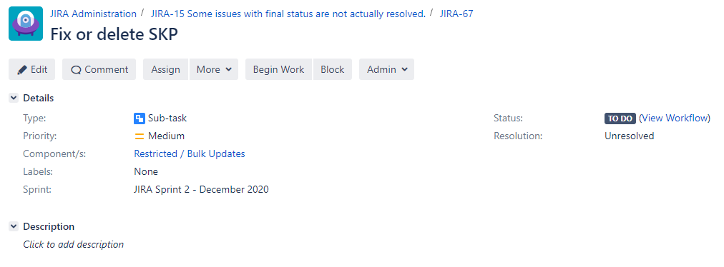
Issues and Sub-tasks
Sub-Tasks are issues, but with a parent/child relationship to another issue.
Using options under the More menu:
You can add sub-tasks to an existing issue
You can convert an existing issue to a sub-task; you will need to provide the key of the desired parent issue.
You can convert a sub-task to a regular issue type
By default, resolution of the parent is independent of the children (you can close a parent with opened children), but that can be prevented via workflow transition validators.
Sub-Tasks (children) display on the parent issue under the Sub-Tasks heading.
The parent is displayed in the breadcrumbs of the child issue…

Slide 15
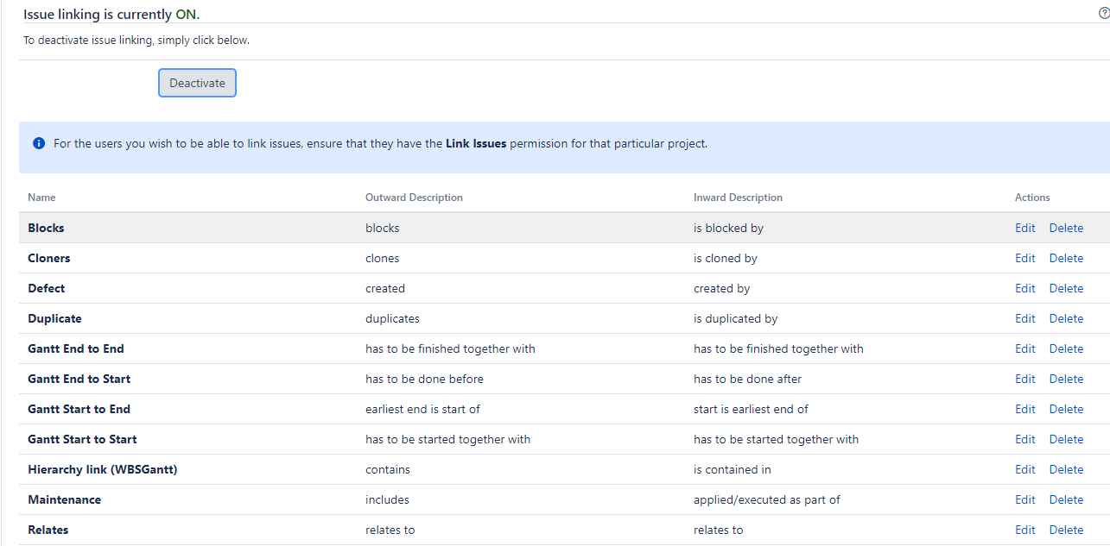
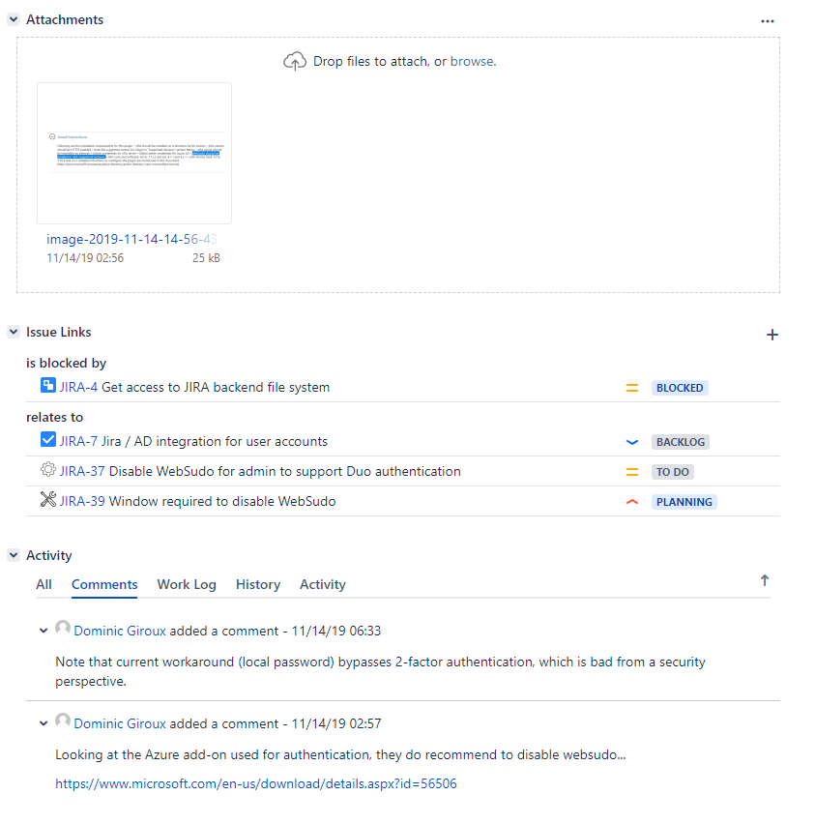
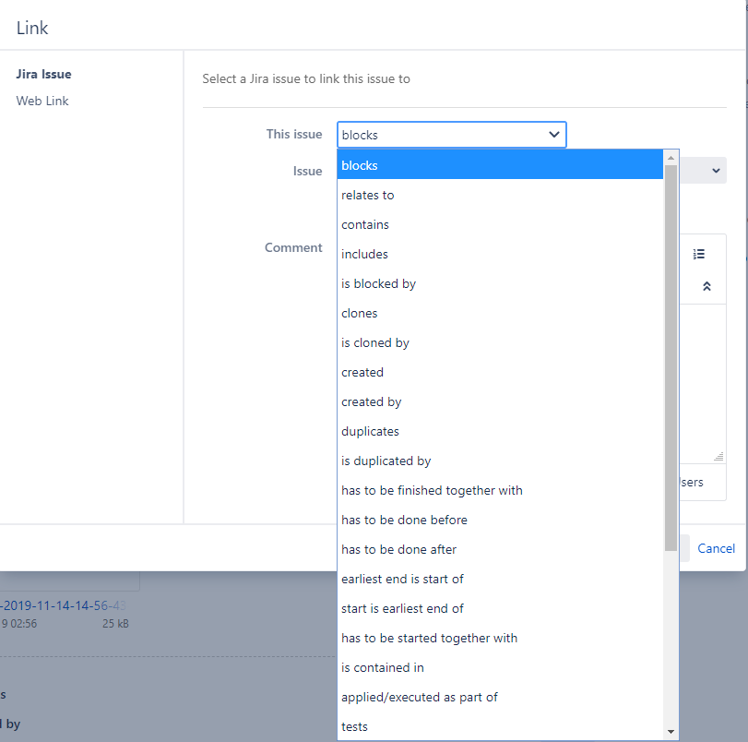
Issue Linking
Beyond the parent/child relationship of sub-tasks, JIRA lets you defined any number of issue linkage
Each link has an inward and outward description
The definition of these relationship does not have cardinality; they are effectively N..N (many to many) relationships
Issue Links are configured globally, not by project
Use the Link option in the More action menu to invoke the link dialog.
When linking issues with different inward/outward descriptions, which issue you start with and what description you select matter!
You can also link to any external URL (Web Link)
Linked issues are displayed on the Issue Links section of the issue view page, grouped by link descriptions.
Link will show on both issue, but with opposite inward/outward descriptions.

Slide 16
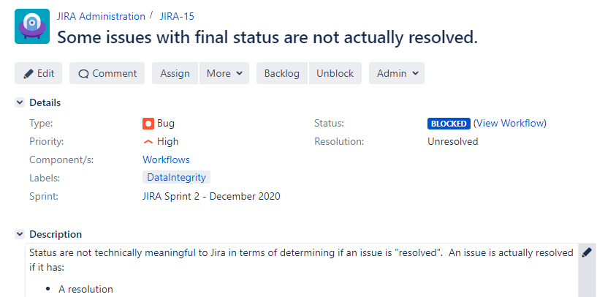
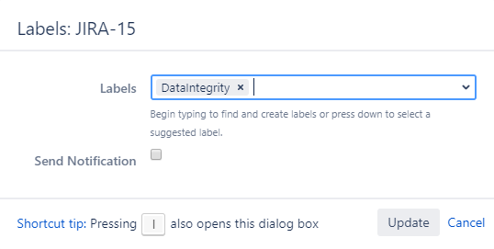
Labels
Free-form “tagging”.
Anyone can create labels
Previously used labels are suggested, but no consistency enforced.
Single word, no spaces.
Can be used later when filtering issues.
Best Practice: If you need consistency in data entry and reporting, consider using a single or multi-value list with fixed values
(custom field)
Use of the label dialog (from the More menu, or using the “l” shortcut (lower-case L) allows you to trigger a notification

Slide 17
Introduction to the project
What’s a project and how to work with one

Slide 18
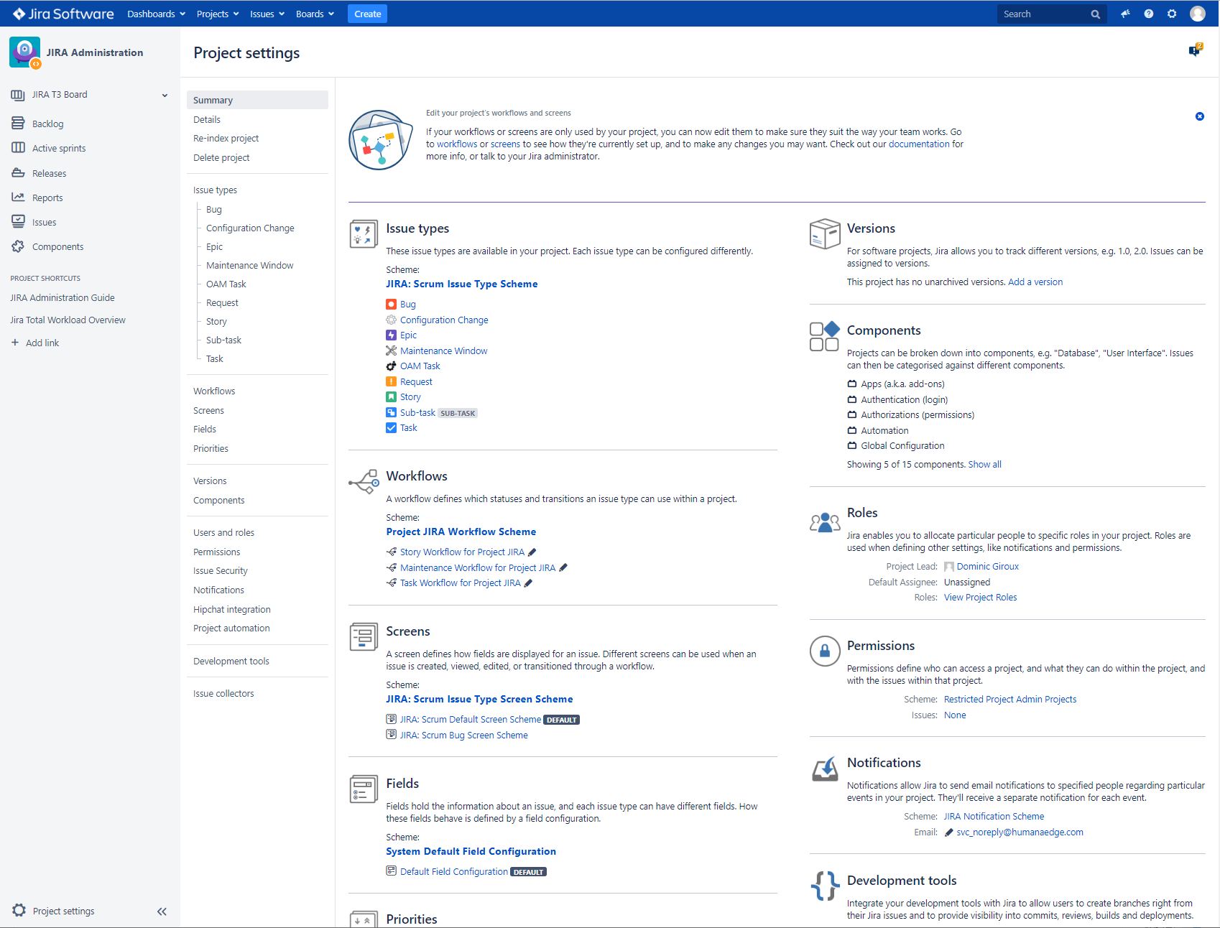
What’s a Jira Software project
Project settings define:
User, roles and based on the assigned permissions scheme, data visibility and access
Project-specific versions and components
Available issue types, assigned workflows and screens, field configuration (what fields are visible)
Who gets notified of various actions on your issues
Explore your project settings
(project admins)
Live Demo!
Project Administrator can define versions and components, assign users and roles, and if granted extended project administration privileges, can also manage workflows and screens

Slide 19
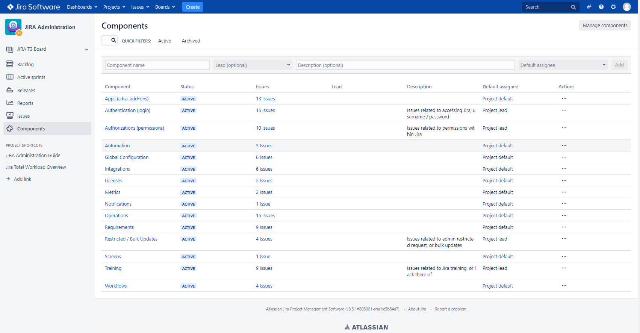
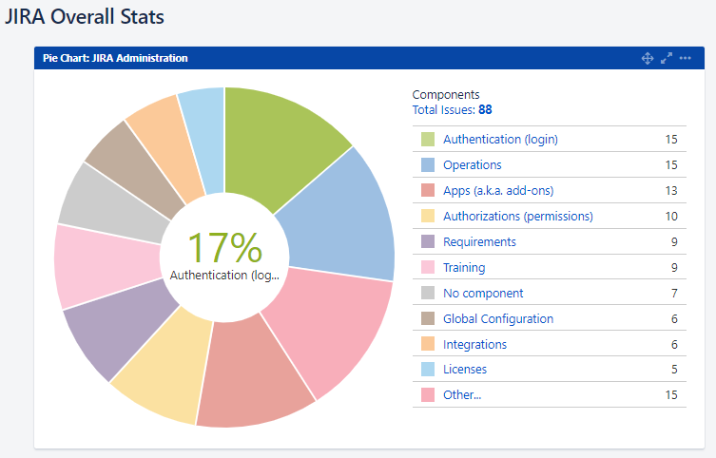
Project Components
Components let you break down your project and drive default assignment by component (if desired).
Components are often used for filtering and reporting.

Slide 20
Moving an issue
Accessible from the More action menu
Move an issue to a different project
This will modify the issue key
JIRA will remember the old key so external links will still work
Move an issue to an incompatible issue type
If issue types have different workflows, you need to use the move functionality
If two issue types share the same workflow, you can simply change the issue type field directly, no need to move!
Live Demo!

Slide 21
Working with multiple issues
Jira core functionality

Slide 22
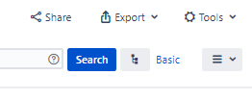
Searching Issues
Select Search Issues from the Issues menu
Supports two query modes:
“Basic” – drop-down filters
“Advanced” –JQL (Jira Query Language – very SQL-like) editor with auto-complete
Results can be presented in two modes:
Detailed View – key / summary list on the left, and issue view screen on the right
List View – screen-wide list allowing to customize what fields to display in what order
Live Demo!

Slide 23
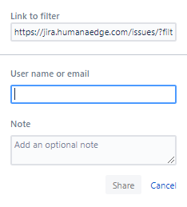
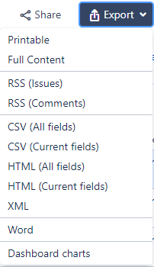
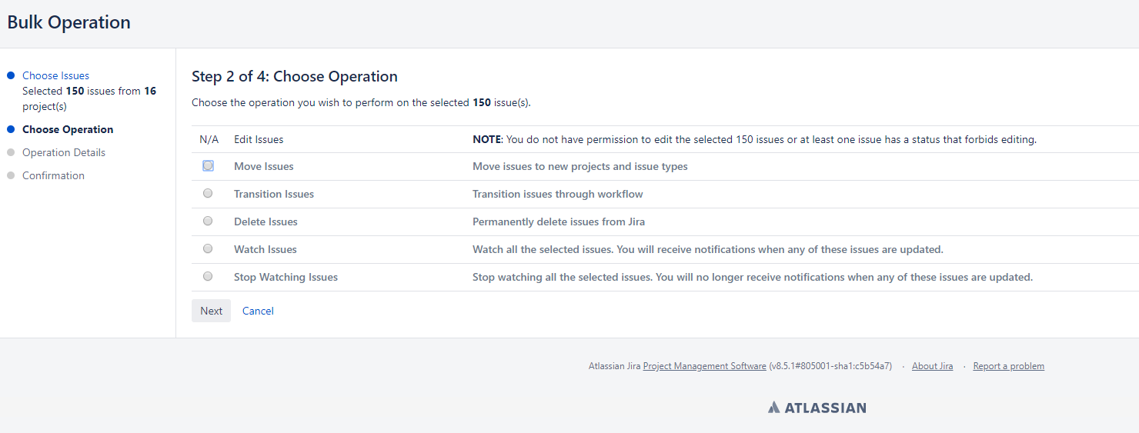
Sharing, Export and Bulk Updates
You can share ad-hoc searches and results via email
You can export the data in various format
You can perform bulk activities on the results (or a subset)

Slide 24
Filters / Subscriptions
Frequent Searches can be saved as a Filter
Favorite filters show under the Issues menu; use the star to favor / unfavor
You can manage all your filters, and search for public filters from the Managed Filters option in the issues menu
You can share your filters with others
You can save your field selection (and order) with your filter
You can create subscriptions for your filter
Essentially, you schedule your filter to run and email you the results!
Live Demo!

Slide 25
Working with multiple issues
Jira Software Agile Features

Slide 26
Jira Software – Implementing Agile
JIRA Software supports both Kanban and Scrum
Implements agile concepts:
Configurable Kanban/Scrum Boards and Cards
Epics and Sprints for Scrum, with additional screens to manage backlog and sprint planning and content
Additional agile reports

Slide 27
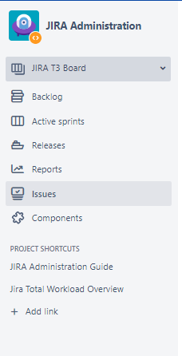
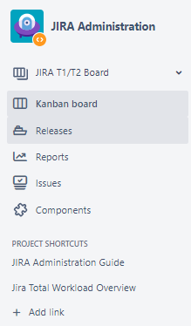
Project Navigation – Context-Sensitive to current Board
Select between boards available for your project
Your Kanban board
Backlog and sprint planning board
(Scrum Only)
Use of this screen ties into the Product Increment / Sprint planning process, a story for another day…
Several search and reporting options are also available from the Project panel visible on both Kanban and Scrum boards.
Default report may vary based on currently active board.
Scrum Board for Active Sprint(s)
Your project admin can also add custom links under project shortcuts to help you navigate to other tools and repositories
Live Demo!
Scrum
Kanban

Slide 28
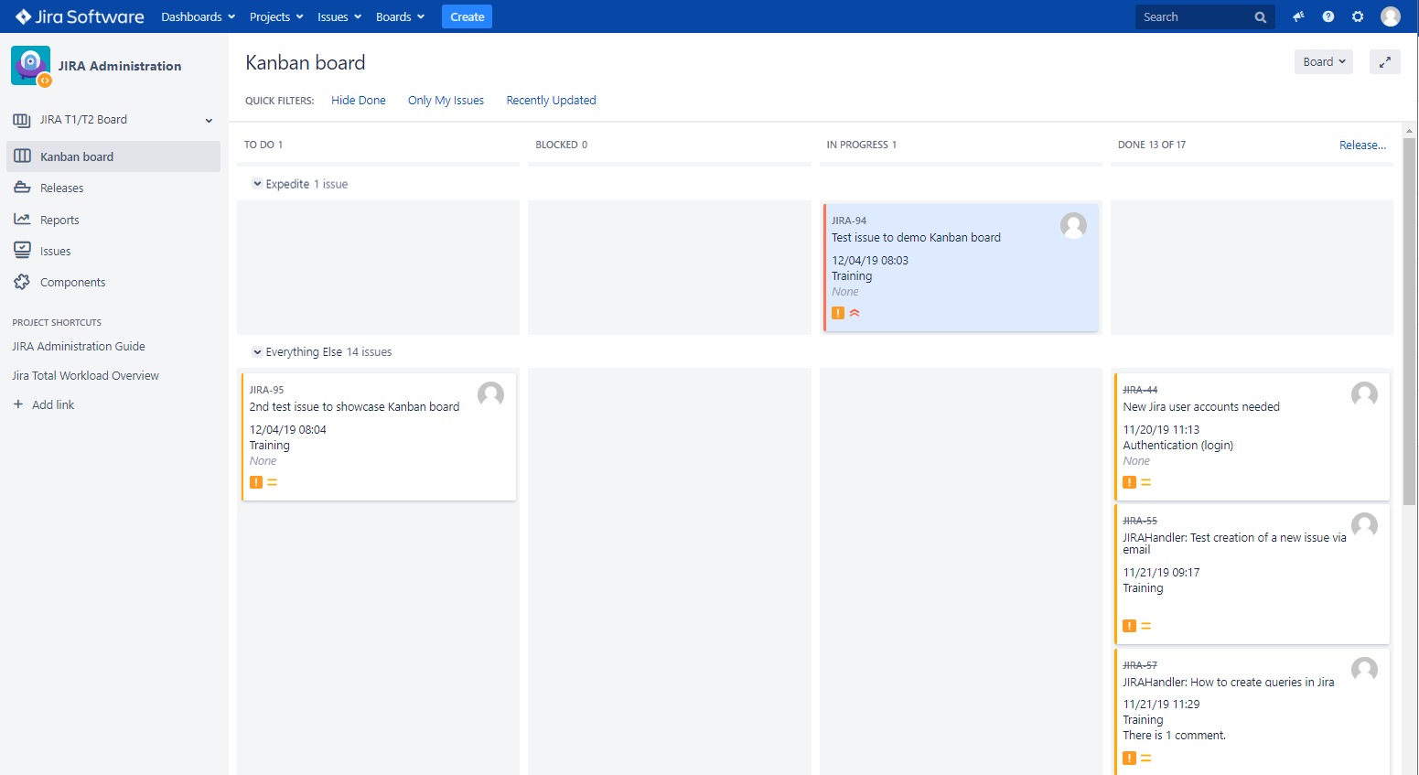
Board Overview – Common characteristics of Kanban and Scrum Current Sprint boards
Card (an issue!)
Configurable swimlanes
Column, driven by status(es).

Slide 29
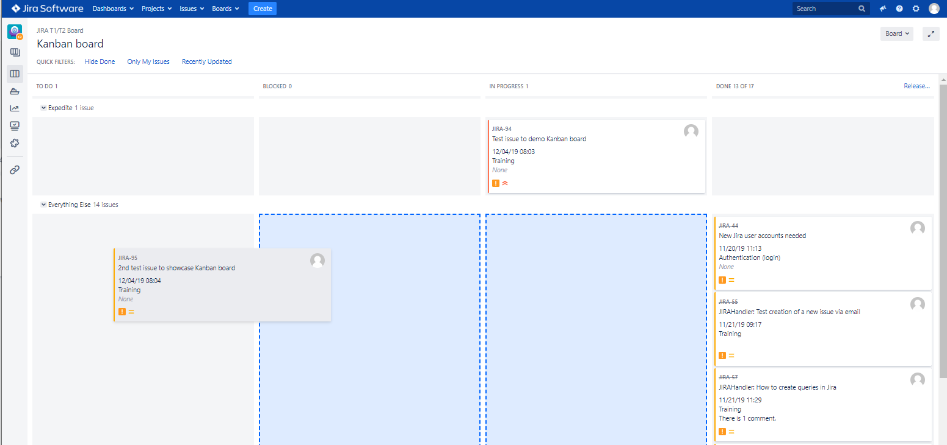
Board – Drag and Drop Transitions
Start dragging, and the board will show you available target columns based on current status and available transitions based on issue’s workflow.
Transition screen (if configured) will popup when you drop…

Slide 30
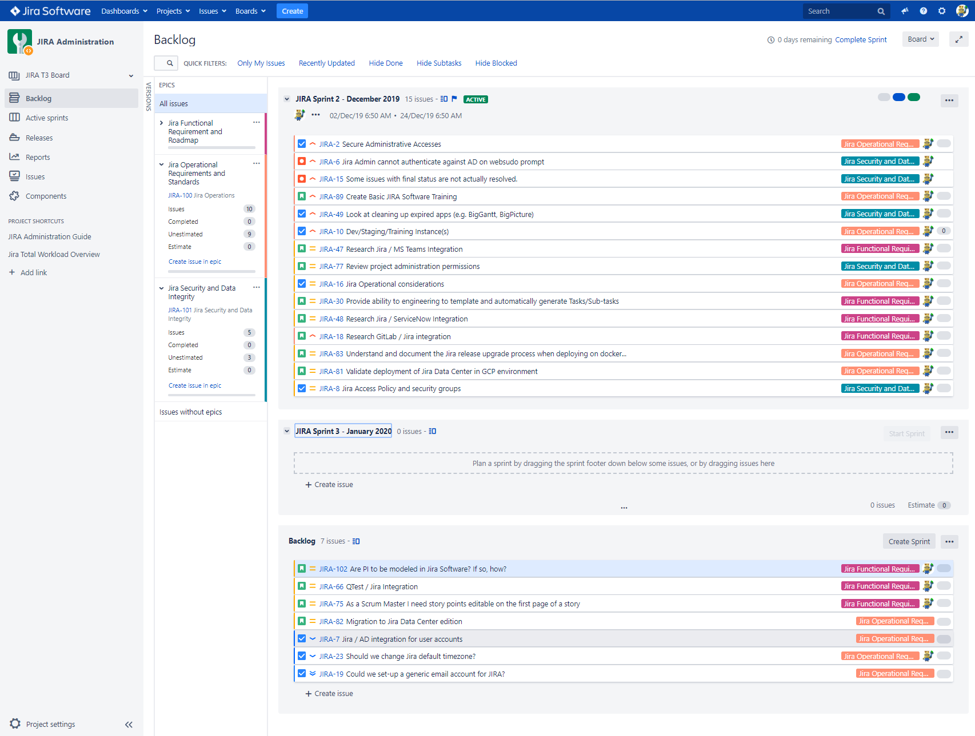
Scrum Backlog and Sprint Planning board
Define your own quick filters
Filter by Epics or Versions
Create and plan your future sprints and populate them by dragging top ranked issues from your backlog
Drag and drop your backlog issues to rank them (filter must be ordered by rank ascending)

Slide 31
Miscellaneous
Dashboards, Apps, Automations

Slide 32
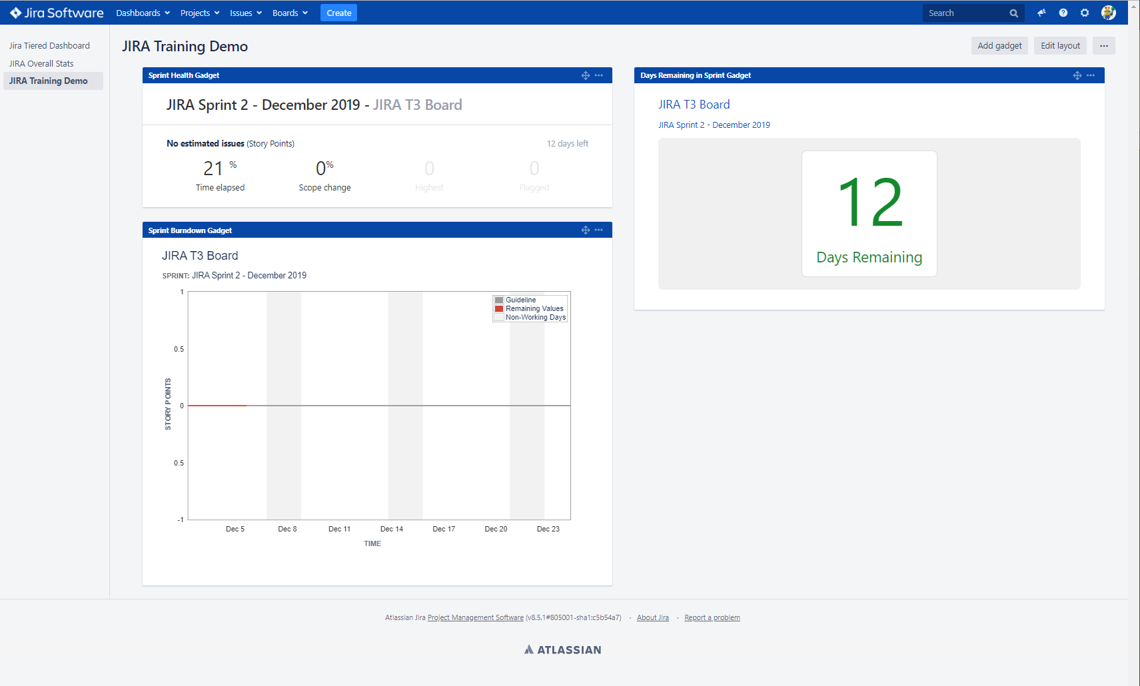
Jira Dashboards and Gadgets
Anyone can create and shared dashboards where you can use gadgets to look at your data.
Live Demo!

Slide 33
Jira Marketplace
Atlassian creates extensions for Jira called Apps (a.k.a. add-ons).
They also allow 3rd-Party to develop Apps and offer on the Jira Marketplace.
Some are paid, some are free.
Some are great and useful, some not so much.
All need to be evaluated from a functional, performance and security perspective.
We are planning a Jira development / training instance where we can safely evaluate Apps and other significant configuration changes before deploying to production.
Live Demo!

Slide 34
Automations
We’ve acquired two Apps that significantly increase Jira automation capabilities:
ScriptRunner: Allows the use of groovy scripts to access Jira’s APIs and implement automatic behavior on Jira’s internal events (e.g. issue created) and transitions (e.g. Validators, Post Functions) or apply complex data manipulations on filter results.
Automation for Jira: An automation workflow engine providing some powerful automations on a variety of triggers. Example: process some automation on all issues in a Sprint when the Sprint is started
These tools allow the global administrators and/or project administrators to implement automatic behavior and make the platform easier to use for all users.
Example: Engineering has expressed a potential requirement to automatically generate several Tasks/Sub-tasks whenever an issue is committed to a Sprint.

Slide 35
Documentation
Learning more about Jira Software

Slide 36
Atlassian Documentation
Atlassian provides extensive documentation on the tool / platform.
But uber configuration comes at a price: Atlassian does not know how Edge is using the tool, and some internal documentation / training will likely be necessary.
You can go to https://confluence.atlassian.com/jirasoftwareserver or simply google to get started.
Make sure you use the Jira Software Server 8.5 release documentation

Slide 37
Getting Help
How to request help from your Jira Administrator(s)

Slide 38
Requesting Help
Preferred:
Create a Request in the Jira Administration (JIRA) project. Click here.
Other Methods:
Email or Team Chat c-dominic.Giroux@humanaedge.com

Slide 39
Appendix A - More on Workflows
Transitions and advanced behavior

Slide 40
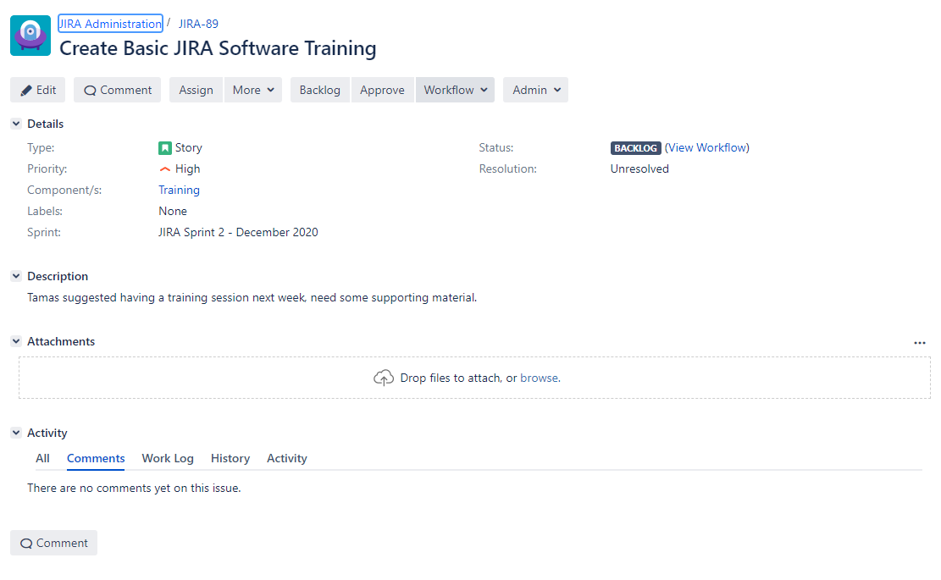
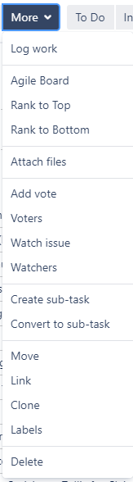
Issue View Screen – Actions / Transitions
Workflow Transitions
ACTIONS
Will bring up the Issue Edit Screen for the current “context”.
The Edit screen can be invoked at any time, from any status, and is usually designed to be “generic” and let you edit any field on the issue. All changes made on the edit screen before clicking OK will be in one “transaction”.
You can also change most fields directly by clicking on them (in-line editing). Each change will be its own transaction, and may trigger notifications or automations…
Agile Ranking
Covered in later slides
Issue Type Screen Schemes allow administrators to configure different edit screens (as well view and create screens) for different issue types / projects contexts!
Live Demo!

Slide 41
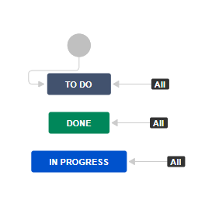
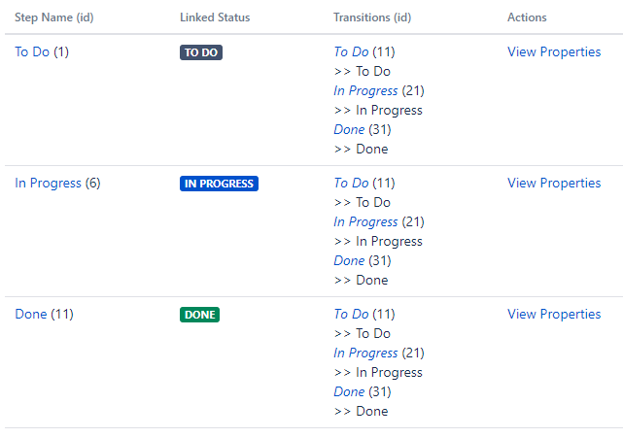
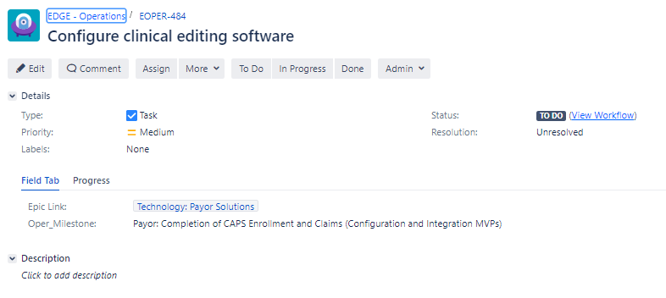
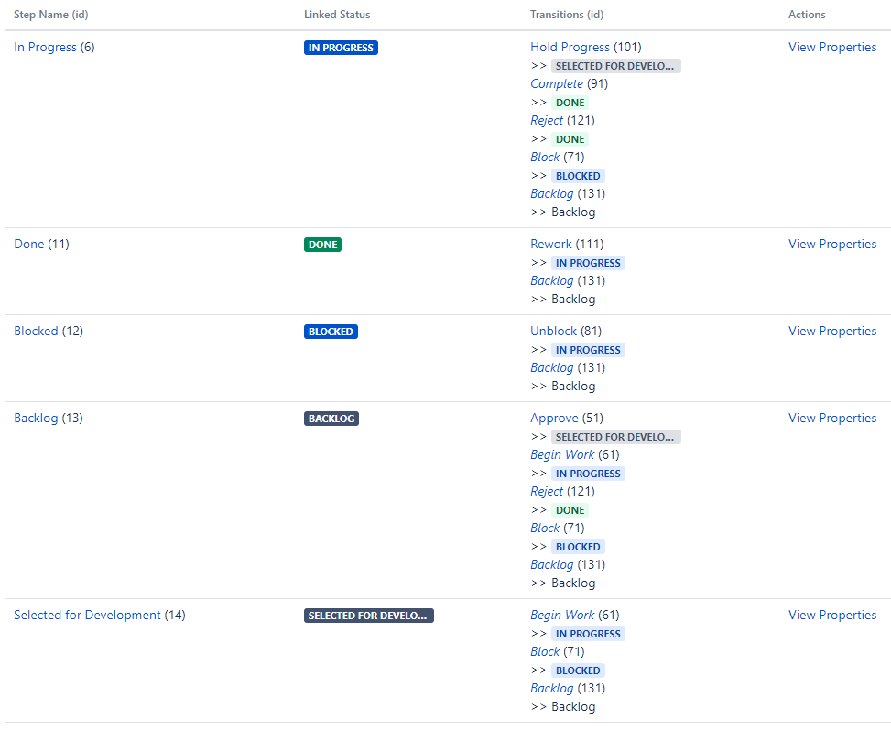
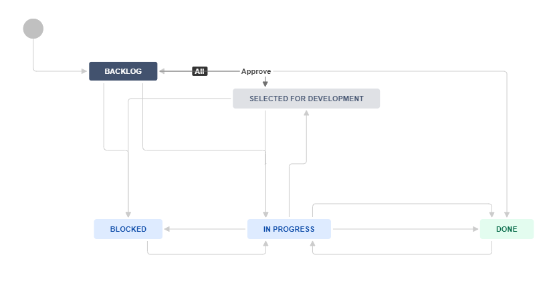
Workflows and transitions
Workflows, transitions and screens can be customized by Jira administrator (all projects) and by users with extended project administration privileges (selected projects).

Slide 42
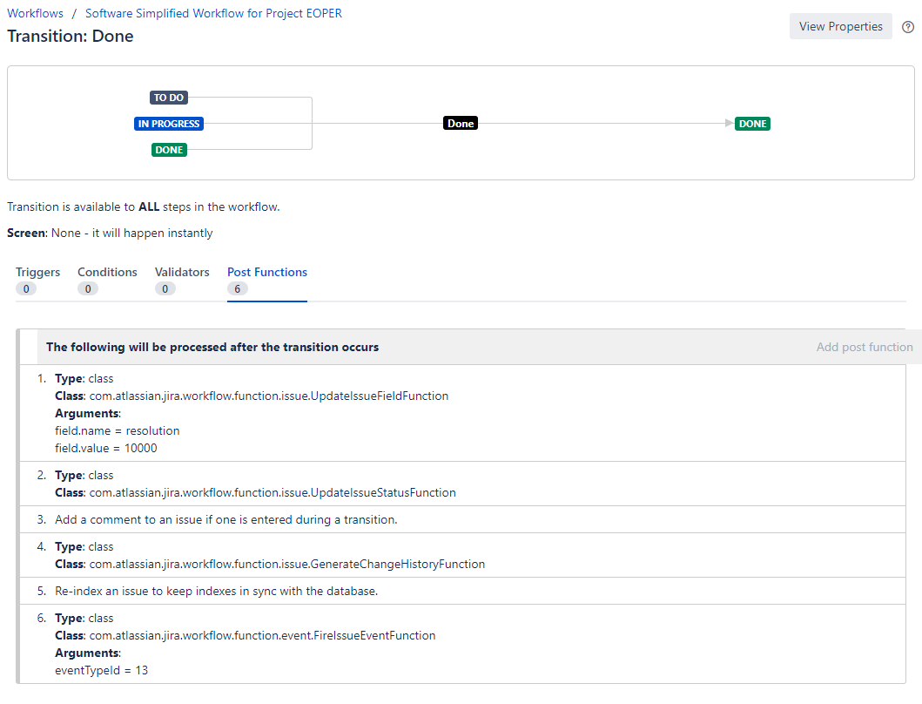
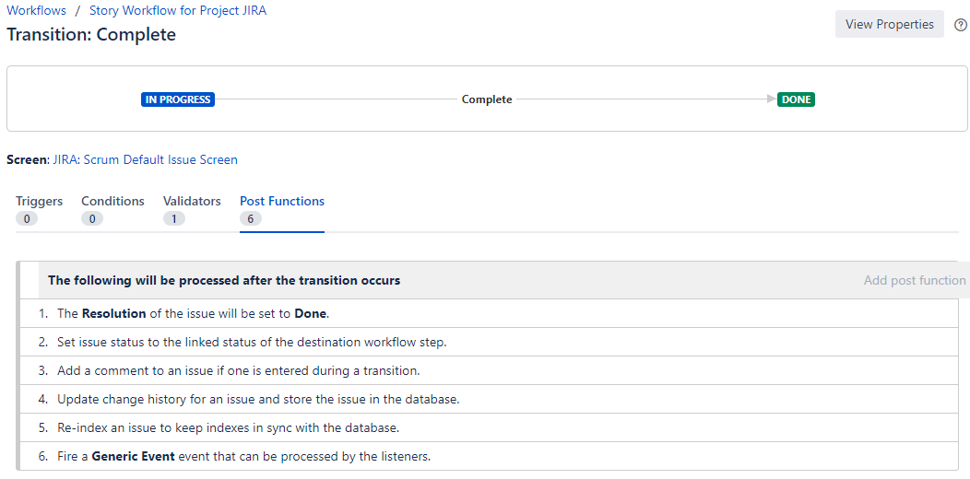
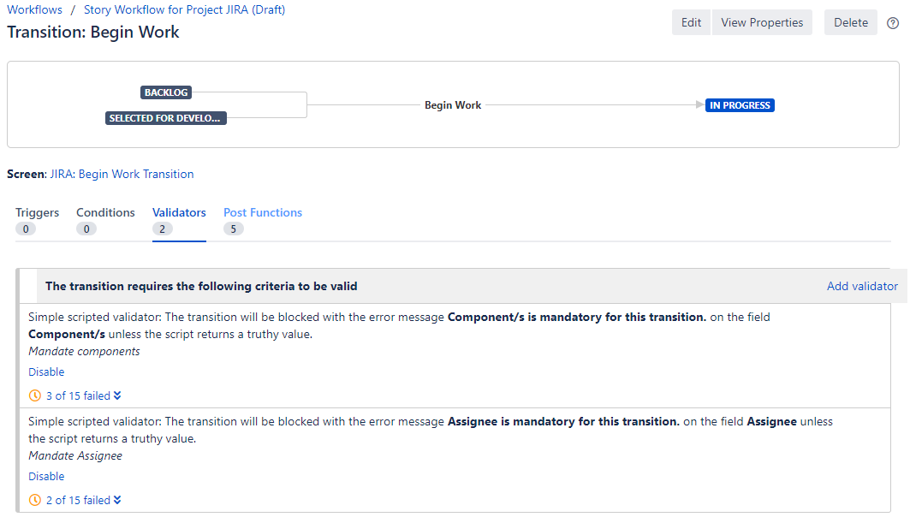
Issue Transitions – Advanced Behaviors
Conditions: must be met for the transition button to appear; can be confusing
Validators: must be met for transition to complete successfully; provide user feedback when not met
Post Functions: actions taken in the background after the transition is validated.
Screen: option to invoke a screen as part of the transition

Slide 43
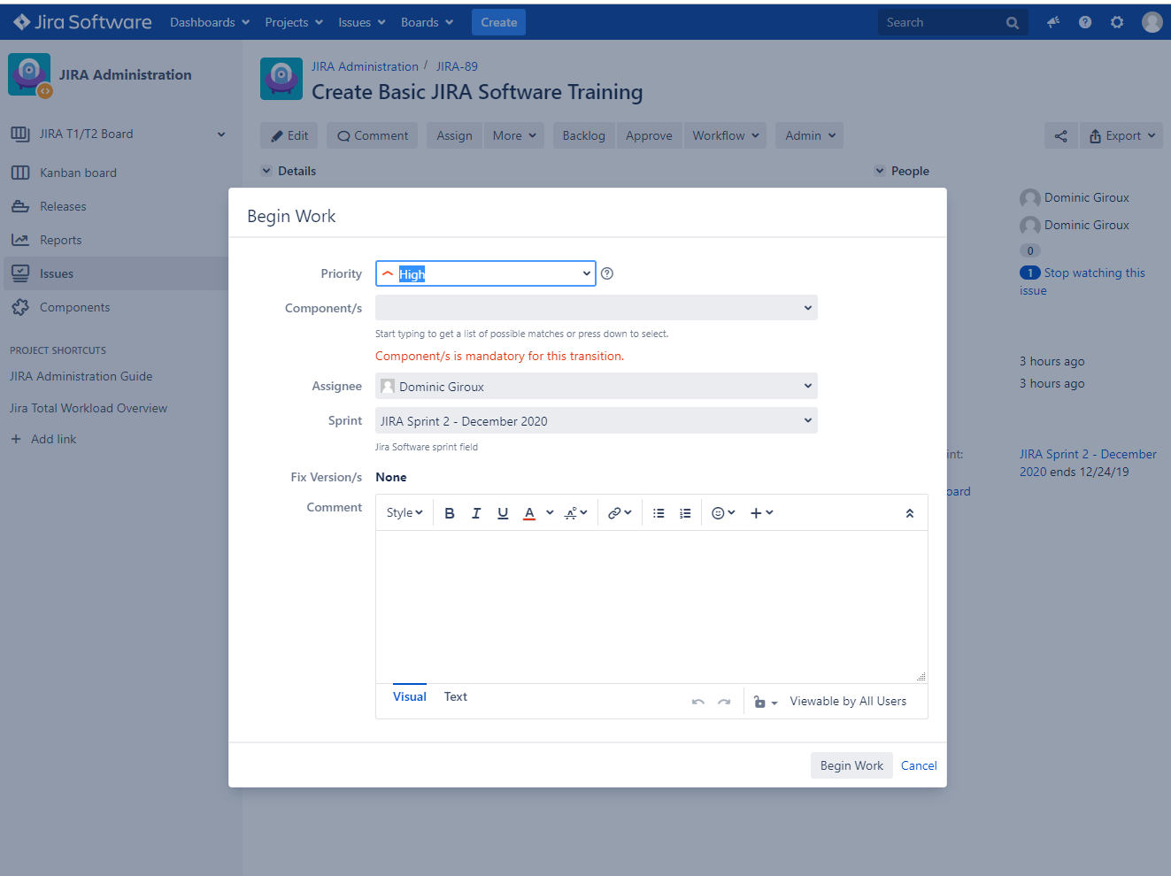
Issue Transitions – Transition Screen and Validator example
Live Demo!

Slide 44
Appendix B – Board Management
How to configure agile boards

Slide 45
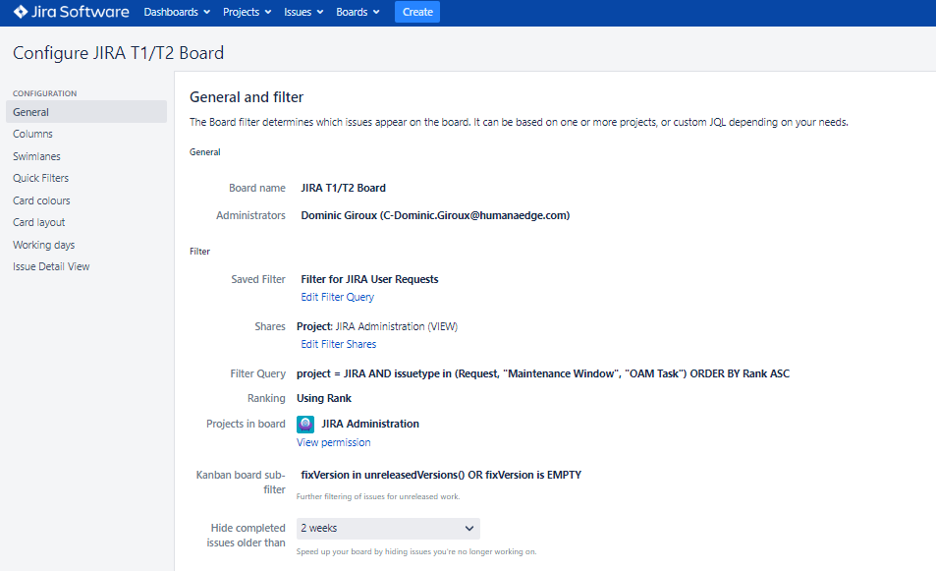
Board Configuration – Issues Selection
Best Practice: Don’t give everyone on the team permissions to re-configure the team board! Users can create and modify their own copy if needed.
Board content is
driven by a saved filter
NOTE: Scrum Boards require ranking by rank for drag and drop to work between backlog and planned sprints. If you use any other ranking, drag and drop is disabled…
You can have many boards for a project (even a mix of Scrum and Kanban) and you can create boards that span projects

Slide 46
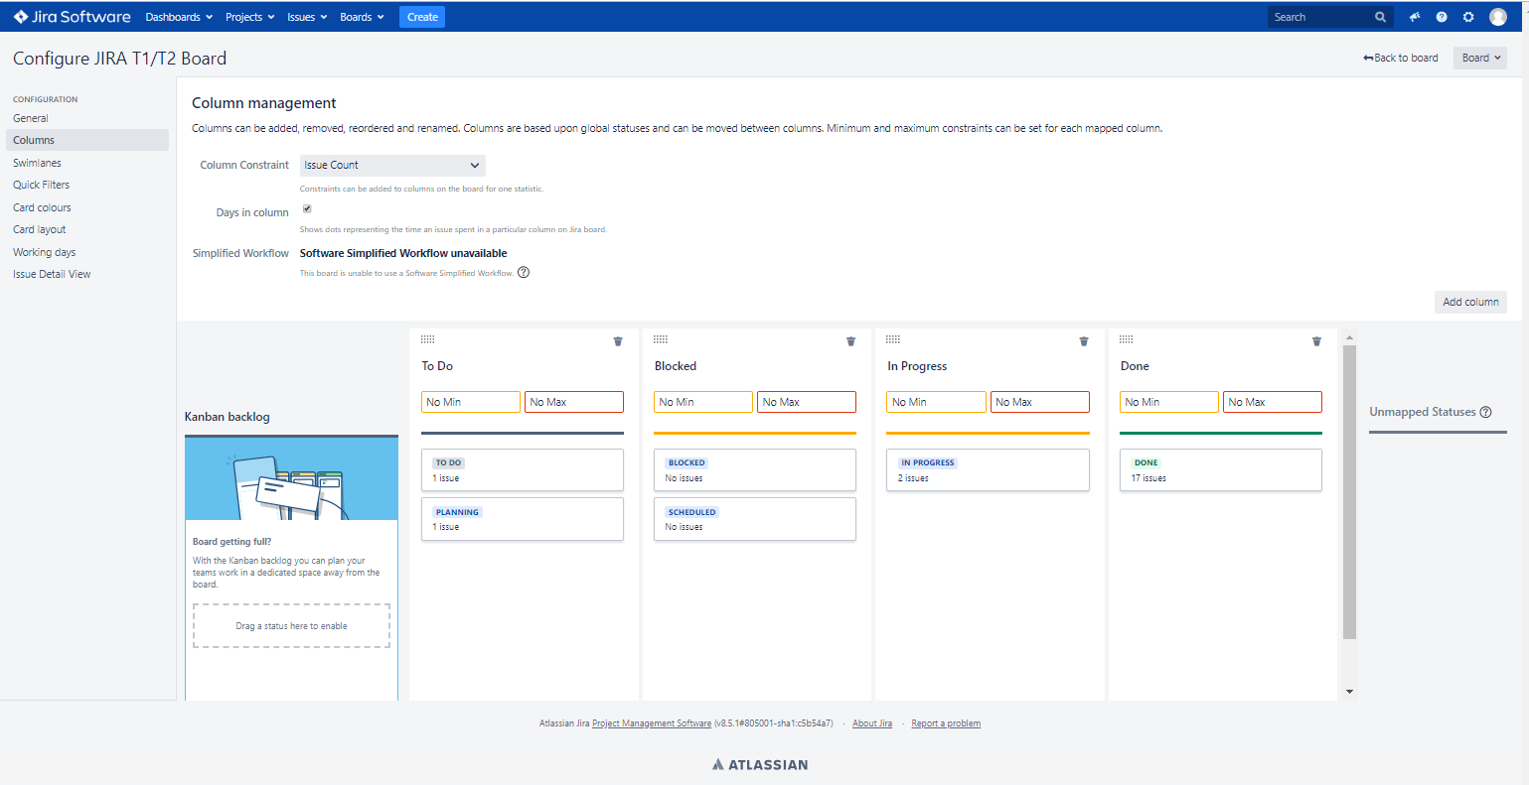
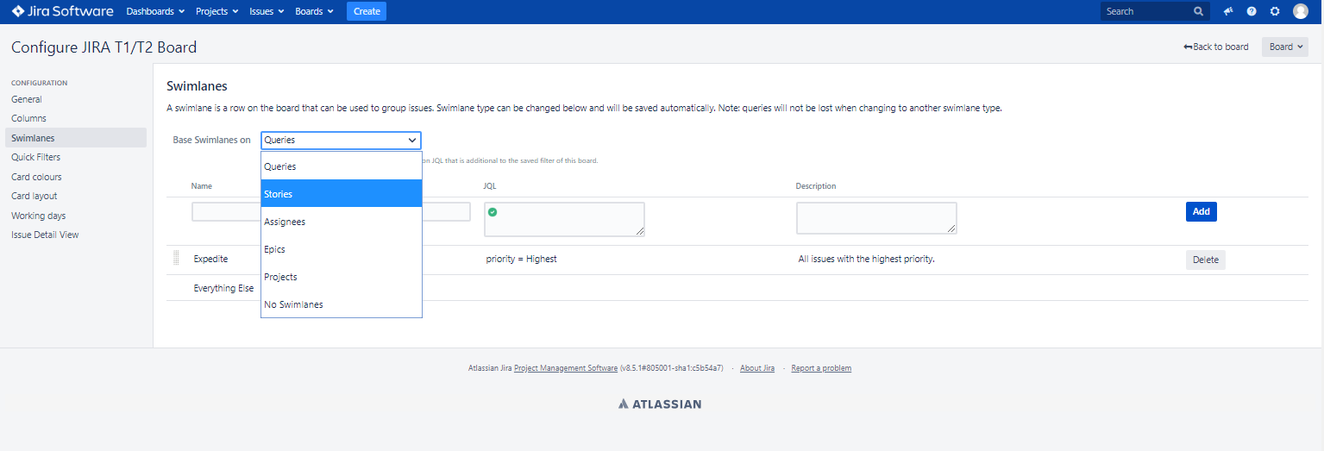
Board Configuration – Columns / Swimlanes
IF using a complex workflow, you get to chose how to map multiple statuses to a (usually) simplified column layout
You also have several options on how to organize your swimlanes

Slide 47
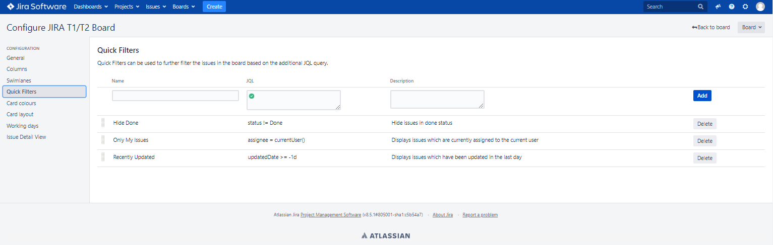
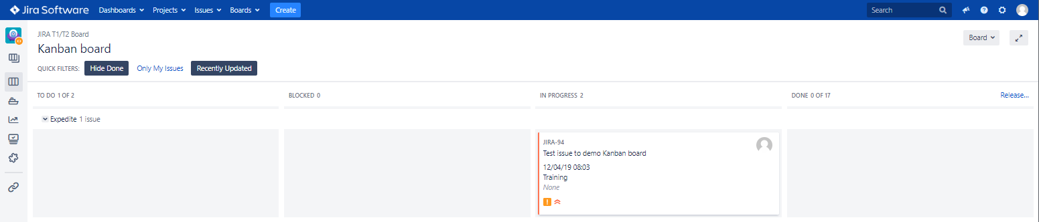
Board Configuration – Quick Filters
Quick Filters are fully configurable and can help you temporarily unclutter a board by focusing on a subset of the board selection.
When viewing the board, you can apply any number of quick filters and their effects, for better or worse, are cumulative!
If your board looks desolate, check your filters! ☺

Slide 48
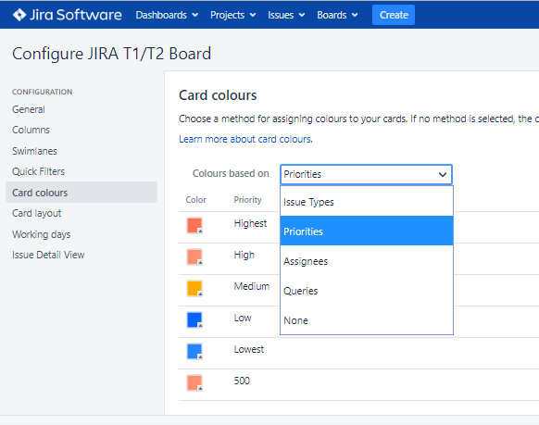
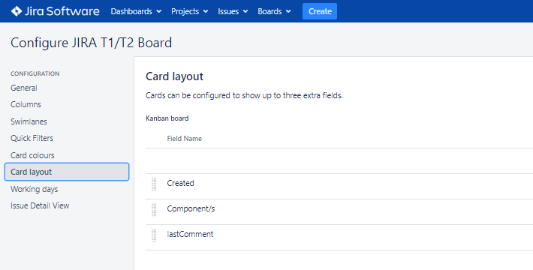
Board Configuration – Cards
You can configure card colors…
…and display up to three (3) fields on the card

Slide 49

Board Configuration – Issue Details
You can also choose what fields to display on the issue detail panel that shows up on the right when you click on a card…

Slide 50
Appendix C – Data Access
How Jira can restrict access to projects and/or issues

Slide 51
Data access and visibility
JIRA can restrict access to issues in different ways:
At the project, through user and role assignments, and optionally through a project-specific permissions scheme
At the issue level
Jira applies its data visibility throughout:
Issues / Projects you do not have visibility on will not show on filters, boards and gadgets
Menu and auto-complete functionality filter out projects and options not accessible to you
If you try to access a restricted issue, you get an error stating it does not exist OR you do not have access to it.
In the Edge implementation, most projects use role-based assignments to restrict access. Roles are assigned by the project administrator. Learn more here.

